Slide 1
HTTP, JSON, AJAX

Slide 2
HTTP
Hypertext Transfer Protocol

Slide 3
HTTP - Hypertext Transfer Protocol
HTTP is a protocol which allows the fetching of resources, such as HTML documents. It is the foundation of any data exchange on the Web and a client-server protocol, which means requests are initiated by the recipient, usually the Web browser. A complete document is reconstructed from the different sub-documents fetched, for instance text, layout description, images, videos, scripts, and more.

Slide 4
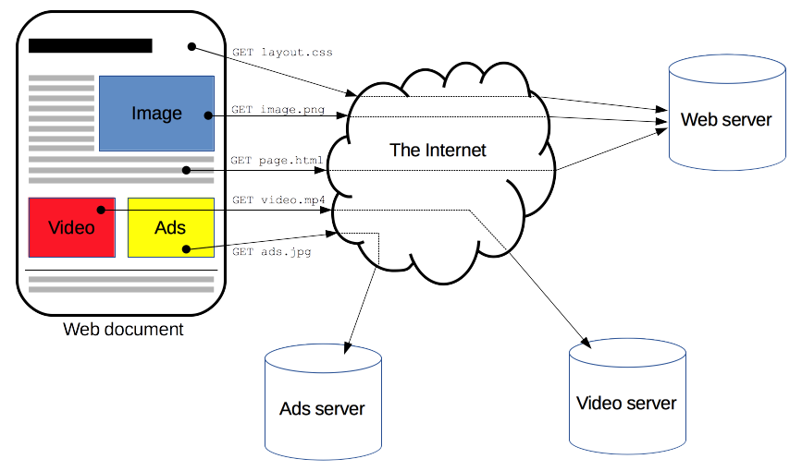
HTTP - Hypertext Transfer Protocol

Slide 5
HTTP - Hypertext Transfer Protocol
Clients and servers communicate by exchanging individual messages (as opposed to a stream of data). The messages sent by the client, usually a Web browser, are called requests and the messages sent by the server as an answer are called responses.

Slide 6
HTTP - Hypertext Transfer Protocol
GET / HTTP/1.1 Host: developer.mozilla.org Accept-Language: fr
HTTP/1.1 200 OK Date: Sat, 09 Oct 2010 14:28:02 GMT Server: Apache Last-Modified: Tue, 01 Dec 2009 20:18:22 GMT ETag: "51142bc1-7449-479b075b2891b" Accept-Ranges: bytes Content-Length: 29769 Content-Type: text/html <!DOCTYPE html... (here comes the 29769 bytes of the requested web page)

Slide 7
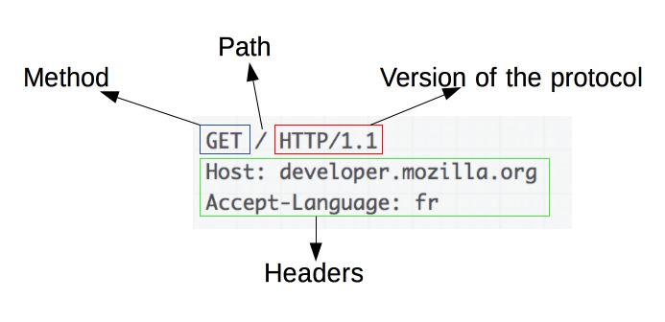
HTTP - Request

Slide 8
HTTP - Request methods
GET
The GET method is used to retrieve information from the given server using a given URI. Requests using GET should only retrieve data and should have no other effect on the data.
POST
A POST request is used to send data to the server, for example, customer information, file upload, etc. using HTML forms.

Slide 9
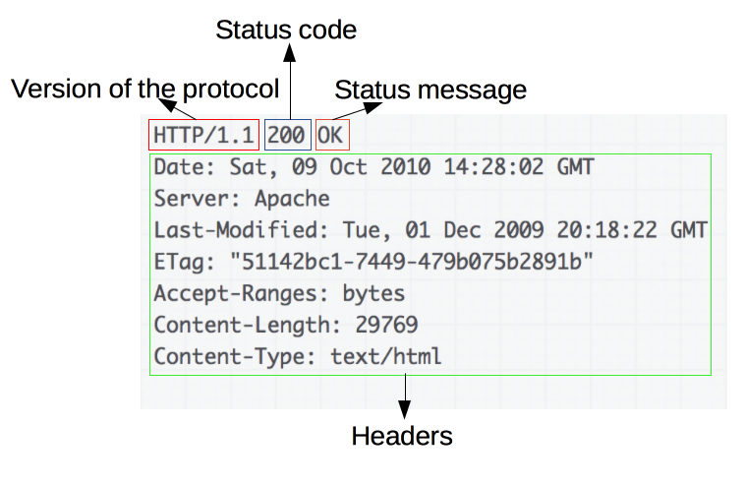
HTTP - Response

Slide 10
HTTP - Response statuses
1xx: Informational It means the request was received and the process is continuing.
2xx: Success It means the action was successfully received, understood, and accepted.
3xx: Redirection It means further action must be taken in order to complete the request.
4xx: Client Error It means the request contains incorrect syntax or cannot be fulfilled.
5xx: Server Error It means the server failed to fulfill an apparently valid request.

Slide 11
HTTP
var xmlHttp = new XMLHttpRequest(); xmlHttp.onreadystatechange = function() { if (xmlHttp.readyState == 4 && xmlHttp.status == 200) console.log(xmlHttp.responseText); } xmlHttp.open("GET", 'https://ghibliapi.herokuapp.com/films/58611129-2dbc-4a81-a72f-77ddfc1b1b49', true); xmlHttp.send(null);

Slide 12
Identifying resources on the Web

Slide 13
URL
The target of an HTTP request is called a "resource". Each resource is identified by a Uniform Resource Identifier (URI) used throughout HTTP for identifying resources. The identity and the location of resources on the Web are mostly given by a single URL (Uniform Resource Locator, a kind of URI).

Slide 14
URL
https://www.example.com:80/path/to/resource?key1=value1&key2=value2#SomewhereInTheDocument
https:// - protocol (http or https)
www.example.com - domain name (or IP address)
:80 - port (80 for HTTP and 443 for HTTPS)
/path/to/resource - path to resource (file)
?key1=value1&key2=value2 - query
#SomewhereInTheDocument - fragment

Slide 15
AJAX

Slide 16
What's AJAX?
AJAX
Asynchronous JavaScript And XML.
The two major features of AJAX allow you to do the following:
Make requests to the server without reloading the page
Receive and work with data from the server

Slide 17
What's AJAX?
var xmlHttp = new XMLHttpRequest();
xmlHttp.onreadystatechange = function() {
if (xmlHttp.readyState == 4 && xmlHttp.status == 200)
console.log(xmlHttp.responseText);
}
xmlHttp.open("GET", 'https://ghibliapi.herokuapp.com/films/58611129-2dbc-4a81-a72f-77ddfc1b1b49', true);
xmlHttp.send(null);
XMLHttpRequest() - The constructor initializes an XMLHttpRequest.
.onreadystatechange - An EventHandler that is called whenever the readyState attribute changes.
.readyState - property returns the state an XMLHttpRequest client is in. (0, 1, 2, 3, 4)
.status - property returns the numerical status code of the response of the XMLHttpRequest. (100, 200, ...)
.open() - initializes a request.
.send() - sends the request.

Slide 18
JSON

Slide 19
JSON
JSON: JavaScript Object Notation.
JSON is a syntax for storing and exchanging data.
JSON is text, written with JavaScript object notation.

Slide 20
JSON Syntax Rules
Data is in name/value pairs
Data is separated by commas
Curly braces hold objects
Square brackets hold arrays

Slide 21
JSON Syntax Rules
Data is in name/value pairs
Data is separated by commas
Curly braces hold objects
Square brackets hold arrays

Slide 22
JSON Data
JSON data is written as name/value pairs.
A name/value pair consists of a field name (in double quotes), followed by a colon, followed by a value:
"name":"John"

Slide 23
JSON Data
In JSON, keys must be strings, written with double quotes:
JSON
{ "name" : "John" }
JavaScript’
{ name : "John" }

Slide 24
JSON Values
In JSON, values must be one of the following data types:
a string
a number
an object (JSON object)
an array
a boolean
null
JSON values cannot be one of the following data types:
a function
a date
undefined

Slide 25
JSON parse & stringify
Use the JavaScript function JSON.parse() to convert text into a JavaScript object:
var obj = JSON.parse('{ "name":"John", "age":30, "city":"New York"}');
Use the JavaScript function JSON.stringify() to convert it into a string.
var myJSON = JSON.stringify(obj);

